Slide 1
PowerPoint Office 2008
Tuesday, August 17, 2010
Laurie Brown

Slide 2
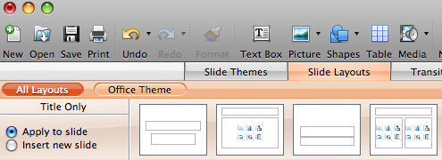
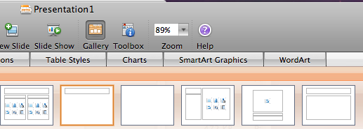
Menus

Slide 3
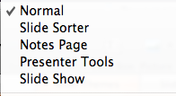
Views and Scripts
Views
Scripts

Slide 4
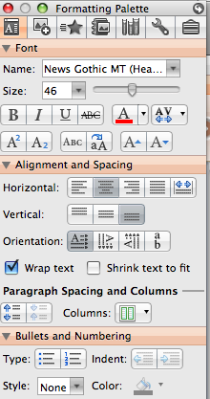
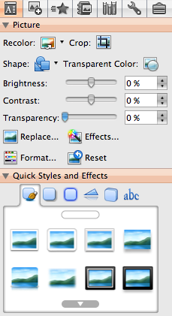
Toolbox

Slide 5
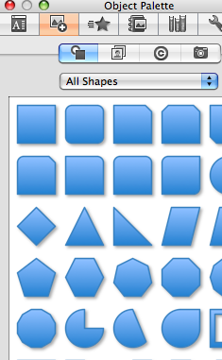
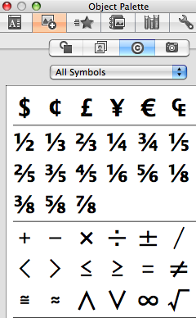
Toolbox

Slide 6
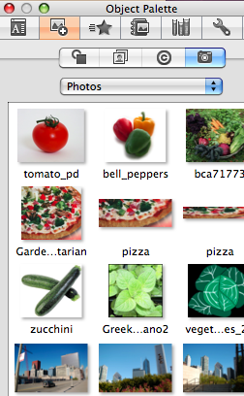
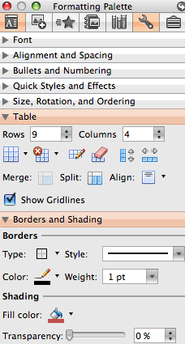
Toolbox

Slide 7
Smart Art
Fonts
Views
Toolbox

Slide 8
Slides From…

Slide 9
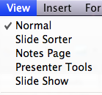
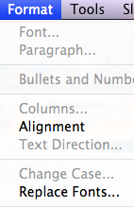
Dynamic Views & Font Replacement
Dynamic Guides
Replace Fonts

Slide 10
Pictures
Watermark

Slide 11
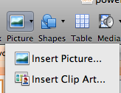
Pictures
Slide Layout
Title and Content
Insert Picture or Clip Art

Slide 12
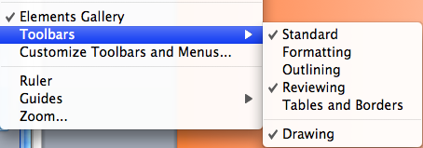
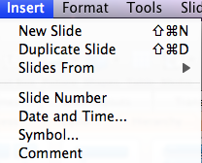
Comments
Reviewing Toolbar found under View menu
Insert Menu > Comment
Comment Toolbar
Sample Comment

Slide 13
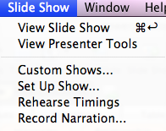
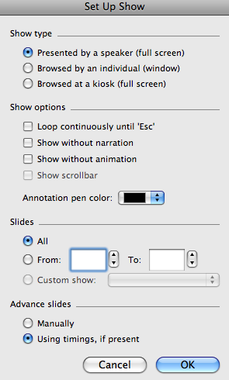
Slideshow Menu

Slide 14
Presenter Tools

Slide 15
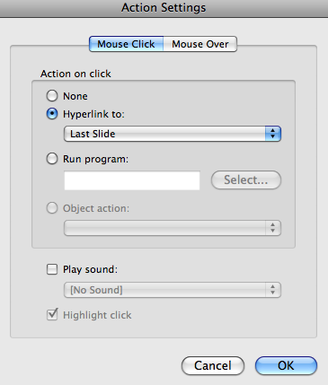
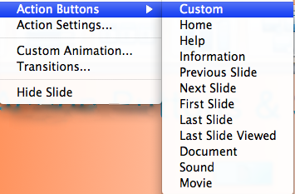
Action Buttons & Settings

Slide 16
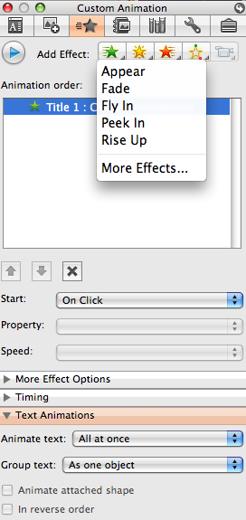
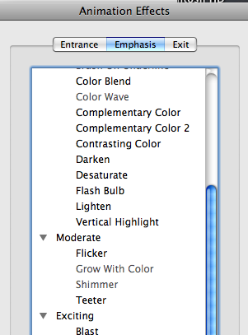
Custom Animations

Slide 17
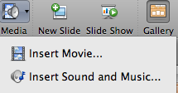
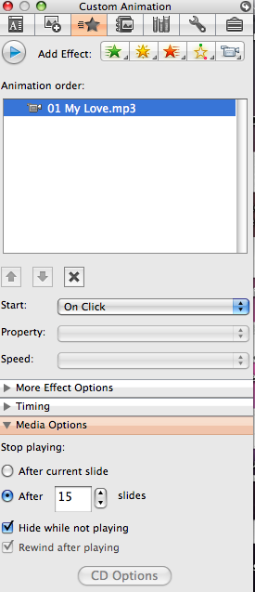
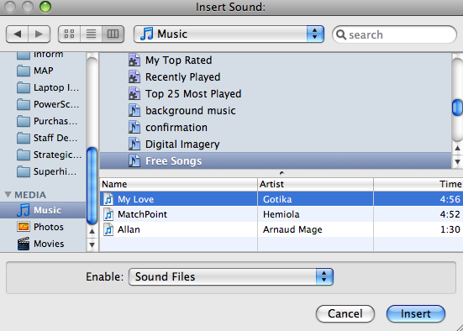
Music and Sounds

Slide 18
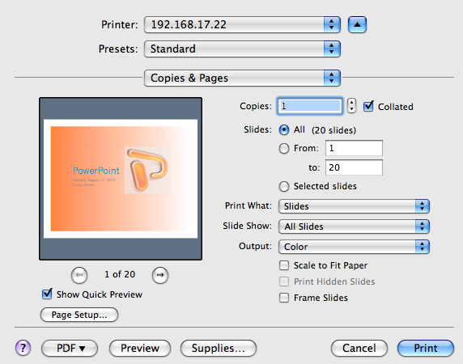
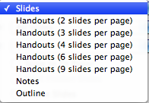
Printing

Slide 19
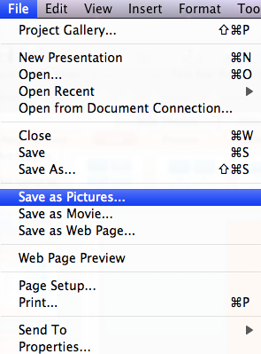
Save As…
Movie
Web Page

Slide 20
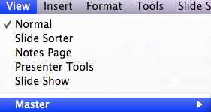
Master Slides

